Slide 1





Introduction to Robotic Process Automation
OFFER LETTER GENERATOR / HR USE CASE
220701196
Pradeep S
Guide Name
Computer Science and Engineering

Slide 2
Abstract
This project focuses on automating the offer letter generation process using UiPath, providing an efficient and scalable solution for HR departments. It comprises two key modules: Dispatcher and Performer.
The Dispatcher extracts candidate information from an Excel sheet, filters the "Hired" candidates, validates the data, and adds it to the UiPath Orchestrator Queue. The Performer, currently under development, will generate offer letters in a poster format and send personalized emails to the selected candidates.By integrating UiPath Studio with Orchestrator, the solution supports robust workflow management, logging, and error handling. Future enhancements aim to further streamline the process and extend functionality to accommodate diverse organizational needs.

Slide 3
Need for the Proposed System
The traditional method of generating and sending offer letters involves significant manual effort, which can lead to errors, delays, and inefficiencies. In high-volume hiring scenarios, HR teams face challenges such as managing large amounts of candidate data, ensuring timely communication, and maintaining accuracy in document generation.
The proposed Offer Letter Generator System addresses these challenges by automating the process using UiPath. Automation not only ensures accuracy in data handling but also speeds up the workflow, enabling HR teams to focus on strategic tasks rather than repetitive ones.
This system is essential to reduce manual dependency, improve operational efficiency, and enhance candidate experience by delivering offer letters in a timely and personalized manner.

Slide 4
Advantages of the Proposed System
Efficiency and Speed: Automates repetitive tasks such as filtering candidates, validating data, and generating offer letters, significantly reducing processing time.
Accuracy and Consistency: Minimizes human errors in data handling, ensuring precise and consistent offer letter generation and communication.
Scalability: Handles large volumes of candidate data effortlessly, making it suitable for organizations with extensive hiring processes.
Enhanced Candidate Experience: Sends personalized offer letters with timely delivery, improving the professionalism and reputation of the organization.
Centralized Workflow Management
Cost-Effectiveness

Slide 5
Literature Survey
Paper 1: Robotic Process Automation for IT service in Management
Summary: It explores the application of Robotic Process Automation (RPA) in IT service management. It highlights how RPA can automate repetitive and time-consuming tasks such as ticket handling, data processing, and report generation, reducing human intervention and increasing process efficiency.
Advantages:
Automates repetitive and tedious tasks, reducing manual workload.
Enhances data accuracy by minimizing human errors.
Disadvantages:
Improves accuracy and eliminates manual errors.
Scalable across multiple IT services and environments.

Slide 6
Literature Survey
Paper 2: Automation of Offer Letter Generator: An HR Use Case
Summary: This paper focuses on the automation of offer letter generation processes in HR departments using RPA technologies. It discusses how automating repetitive tasks like filtering candidate data, generating personalized offer letters, and sending them via email can enhance efficiency.
Advantages:
Supports large scale hiring processes, ensuring scalability and consistency.
Simplifies the hiring process by automating key steps, such as filtering and validation of candidate data.
Disadvantages:
Requires specialized knowledge for RPA implementation and maintenance.

Slide 7
Main Objective
The primary objective of the Offer Letter Generator System is to automate the end-to-end process of generating and sending offer letters in HR workflows. This includes extracting and validating candidate data, personalizing offer letters in a poster format, and delivering them via email with minimal human intervention. By leveraging UiPath’s RPA capabilities, the system aims to improve operational efficiency, ensure accuracy and consistency, reduce processing time, and enhance the overall candidate experience during the hiring process.

Slide 8
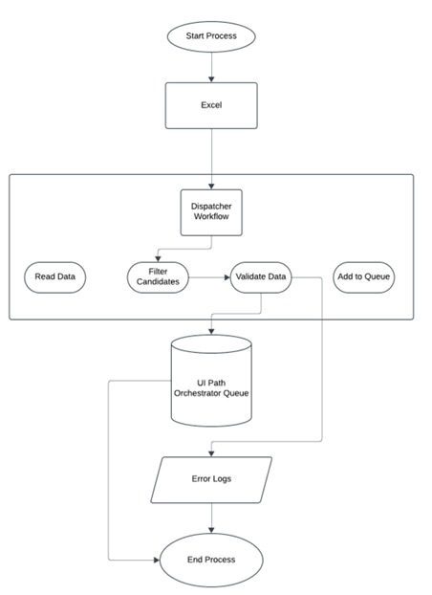
Architecture

Slide 9
System Requirements
Hardware Requirements:
Processor: Intel i5 or higher
RAM: Minimum 8 GB (8 GB recommended for large-scale processing).
Storage: At least 20 GB free space.
Internet: Stable connection for Google Form submissions.
Software Requirements:
RPA Tool: UiPath Studio (Community or Enterprise edition).
Browser: Google Chrome with UiPath extension installed.
Data Source: Microsoft Excel or other structured data formats.
Operating System: Windows 10 or later (64-bit)

Slide 10
Functional Description
Module 1: Initialize and Setup The Initialize and Setup module ensures that all necessary resources, configurations, and connections are established before the automation process begins
Key Functions:
Configure Input Resources:
Initialize Workflow Components
Connect to Orchestrator
Error Handling Setup
Outcome: A properly initialized environment ensures readiness for subsequent modules without interruptions.

Slide 11
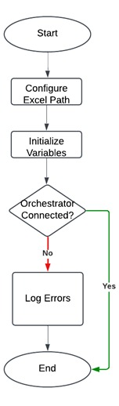
Functional Description
Activity Diagram

Slide 12
Functional Description
Module: Read Data
The Read Data module extracts and prepares candidate information from an Excel sheet for further processing. This step focuses on ensuring data integrity and filtering relevant records.
Key Functions:
Data Extraction
Filter Hired Candidates
Data Validation
Data Storage
Outcome: A clean, validated dataset of hired candidates is ready for addition to the Orchestrator queue.

Slide 13
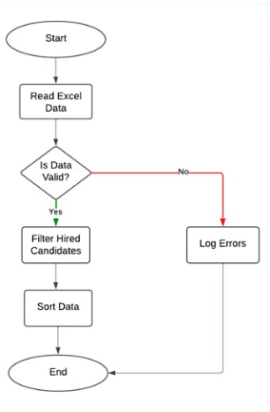
Functional Description
Activity Diagram

Slide 14
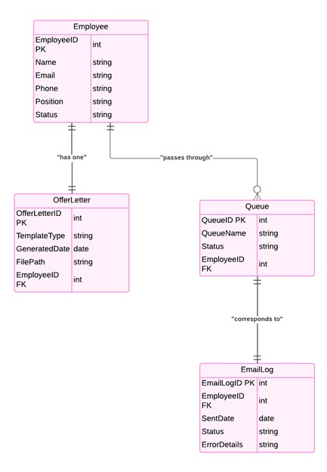
Table Design
Entity Relationship Diagram

Slide 15
Process Design
Process: Overview
To automate the generation and delivery of offer letters for HR operations, ensuring efficiency and accuracy.
Steps in the Process:
Initialize and Setup: Prepare the environment and connect to UiPath Orchestrator.
Read and Validate Data: Extract candidate details from Excel, filter hired candidates, and validate data.
Queue Management: Add validated data to the Orchestrator queue for processing.
Generate Offer Letters: Personalize and format offer letters dynamically.
Send Emails: Deliver offer letters with a personalized message to candidates via email.
.

Slide 16
Process Design
Process: Dispatcher
1. Initialize and Setup:
Configure the Excel file path.
Set up variables and orchestrator connection.
2. Read and Validate Data:
Use Excel activities to extract data.
Apply filters to identify "Hired" candidates.
Validate for missing or incorrect data.
3. Add to Queue:
Push validated data to the UiPath Orchestrator queue.
Include candidate details (name, email, position) for performer processing.
Outcome: Candidates are queued for further action by the performer module.

Slide 17
Process Design
Process: Performer
1. Fetch Data from Queue:
Retrieve candidate information from the Orchestrator queue.
2. Generate Offer Letter:
Use templates to create personalized offer letters in poster format.
Populate letters with dynamic details like candidate name and role.
3. Validate Output:
Check for correctness in generated offer letters.

Slide 18
Process Design
Process: Email delivery and Error handling
1. Send Emails:
Use email activities (e.g., SMTP or Outlook) to send offer letters.
Attach the generated offer letter to the email.
Personalize the email body with a welcoming message.
2. Error Handling:
Log failed email deliveries.
Continue processing for other candidates without interruptions.
Outcome: Offer letters are successfully sent, with robust handling for any errors encountered.

Slide 19
Implementation
Module 1: Initialize and Setup To set up the environment and configure resources for the smooth execution of the automation process.
Activities:
Setup Excel Application Scope: Configure the Excel file path to access candidate data.
Initialize Variables and Arguments: Define necessary variables for data manipulation and workflow interactions.
Establish Orchestrator Connection: Ensure UiPath Studio is connected to UiPath Orchestrator for queue management.
Error Handling Configuration: Set up error handling mechanisms to log any issues during initialization.
Outcome: Environment is prepared, and resources are validated, ensuring a seamless start to the workflow.

Slide 20
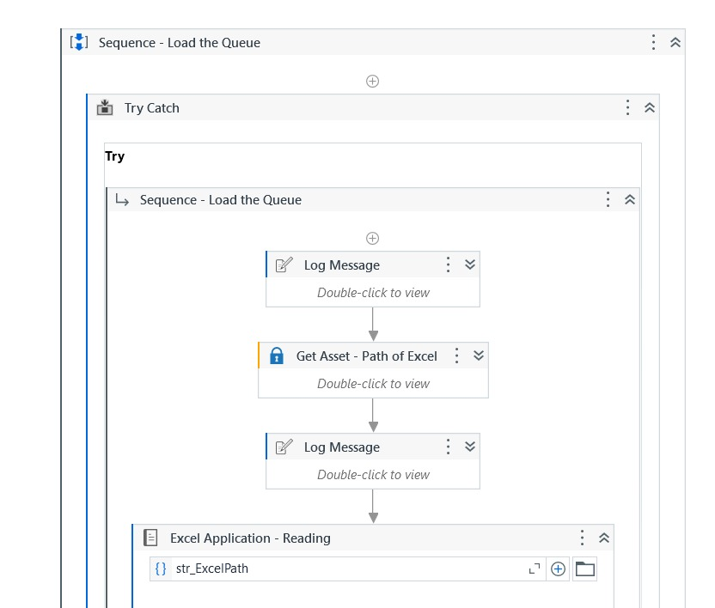
Implementation
Screen Shots

Slide 21
Implementation
Module 2: Read Data
To extract candidate data from the Excel sheet for further processing.
Activities:
1.Read Range Activity: Extract all data from the specified worksheet in the Excel file.
2.Filter Data Table: Identify and isolate rows with the status “Hired.”
3.Validate Data: Check for null or incomplete entries in critical columns (e.g., Name, Email).
4.Store Data in Variables: Save filtered data into a structured format for further operations.
Outcome: Candidate information is extracted, validated, and prepared for subsequent modules in the workflow.

Slide 22
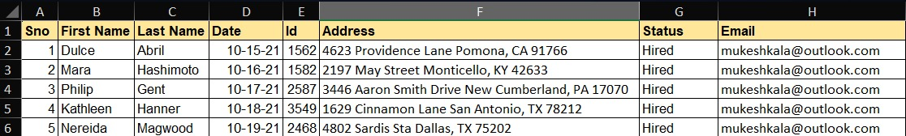
Implementation
Screen Shots

Slide 23
Testing
Testing of the Automated Student Data Entry Project
Testing ensures the functionality, reliability, and efficiency of the
Offer Letter Generator System. Key testing phases include:
Unit Testing: Validates individual components like data extraction, filtering, and email activities.
Integration Testing: Ensures smooth interaction between Dispatcher, Orchestrator, Performer, and external systems.
Functional Testing: Confirms the system performs as per requirements, including data accuracy and offer letter delivery.
Performance Testing: Assesses system efficiency under high loads, such as processing large datasets or handling multiple emails.
Error Handling Testing: Tests the system's ability to log errors and continue processing valid data.

Slide 24
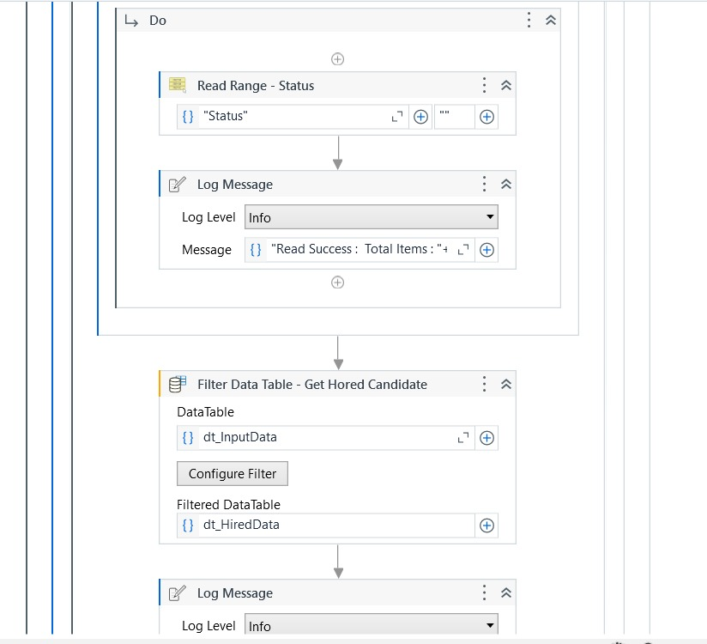
Testing
Screen Shots

Slide 25
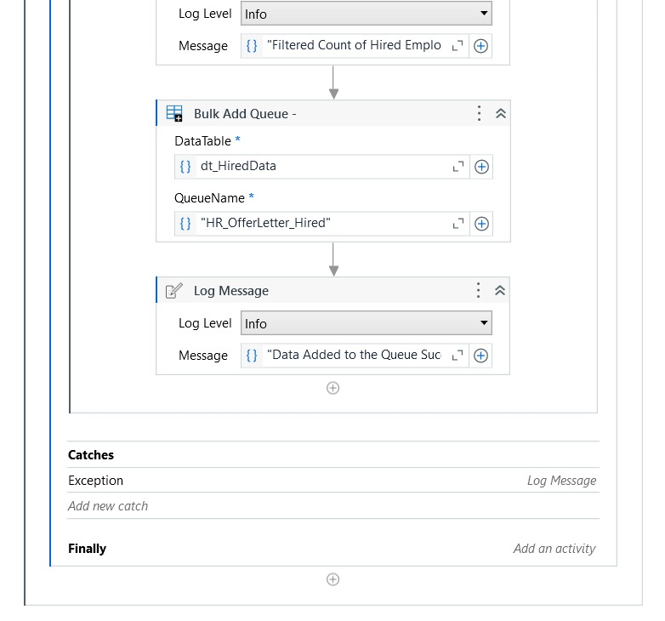
Testing
Screen Shots

Slide 26
Conclusions
The Offer Letter Generator System successfully automates the time-intensive process of generating and delivering offer letters in HR operations. By leveraging UiPath’s capabilities, the system ensures accuracy, efficiency, and scalability in handling large volumes of candidate data. Key outcomes include:
Streamlined Workflow: Integration of Dispatcher and Performer modules reduces manual effort and processing time.
Error Reduction: Automated data validation and error-handling mechanisms ensure higher reliability.
Enhanced Communication: Personalized and professional offer letters are sent seamlessly via email.
This project demonstrates the potential of Robotic Process Automation (RPA) to optimize HR tasks and sets a strong foundation for future enhancements, including advanced error tracking and dynamic offer templates.

Slide 27
Future Enhancement
Future Enhancement 1: Advanced Personalization and Dynamic Offer
Letter Generation
Integration with Dynamic Templates: Enhance the performer to support multiple offer letter templates tailored to different roles, departments, or locations.
Custom Messaging: Incorporate dynamic personalization, such as adding candidate-specific achievements or customized greetings, to improve candidate engagement.
Multilingual Support: Enable the generation of offer letters in multiple languages based on the candidate's location or preference.

Slide 28
Future Enhancement
Future Enhancement 2: Enhanced Functionality and Scalability
Integration with HR Management Systems (HRMS): Connect the automation process with existing HRMS tools for seamless data exchange and tracking.
Real-Time Tracking and Notifications: Implement real-time tracking of email delivery and candidate acknowledgment, providing updates to the HR team.
AI-Powered Data Validation: Incorporate machine learning models to predict and correct potential data inconsistencies during validation.
Scaling for High-Volume Hiring: Optimize workflows to handle larger datasets and multiple hiring campaigns simultaneously, ensuring the system remains efficient as organizational needs grow.

Slide 29
IEEE Paper
Title 1: Robotic Process Automation in HR Operations
Authors: John D. Smith, Alice B. Johnson
Title 2: Automation of Offer Letter Generation in HR Use Cases
Authors: Emily R. Brown, David K. Lee

Slide 30
References
Referals
IEEE Transactions on Automation Science and Engineering
IEEE Access
IEEE Transactions on Industrial Informatics
IEEE International Conference on Robotics and Automation

Slide 31
Queries

Slide 32
Demonstration

Slide 33
Thank You

